Slide 1
Project conducted on
Cement Manufacturing Automation

Slide 2

Project Overview
Title : Cement Manufacturing Automation
The project is to address the business problem of minimizing the time interval between quality checks of cement samples. The purpose of this project is to enhance efficiency, reduce downtime, and ensure consistent product quality. The main aim is to minimize the time between intervals of quality check by 90% and thereby saving a cost of at least $1M. Minimizing the time interval between quality checks can help in early detection of issues, reducing the need for rework and saving on production costs.
Start date: 26/09/2023
End date: 30/10/2023
Organization : 360digitmg
Prepared and presented by: Athulya P
https://www.linkedin.com/in/athulya-ramesan-56693725a

Slide 3

Project Leadership
Bharani Kumar Depuru
Director and Co-Founder at Innodatatics
linkedin.com/in/bharanikumardepuru

Slide 4

Contents
Project Architecture
Business problem
Business objective, constraints and success criteria
Technical stacks
Data collection and details
Exploratory Data Analysis
Visualization
Insights
Challenges
Future scopes
Notes:
Change

Slide 5
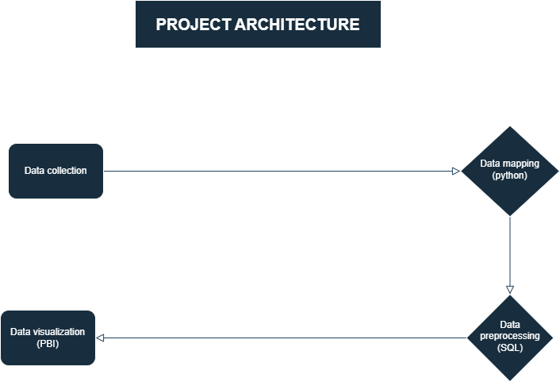

Slide 6
Business Problem
Sample of cement manufactured is taken at a regular interval of 1 hour or so and tested in lab for quality check
Produce large batches of defective items
Quality check on regular intervals
Loss of cost
Potential for human error

Slide 7
Business Objectives, Constraints and Success Criteria
Minimize the time between intervals of quality check
Business objectives
Business Constraints
Minimize manual intervention
Business Success Criteria
Economic Success Criteria
Success Criteria
Reduce the time intervals by atleast 50%
Achieve a cost saving of at least $ 1M

Slide 8
CRISP-ML(Q) Methodology
There are six stages of CRISP-ML(Q) Methodology
1.Business and data understanding
2.Data preparation
3.model building
4.Model evaluation
5.Model deployment
6.Monitoring and maintenance

Slide 9



Technical Stacks

Slide 10
Data Collection and Understanding
Raw material input
For the process of manufactuirng cement, raw materials such as gypsum, DFA, WFA and clinker are needed. The quality and quantity of these are noted.
Process at mill
The mill throughput (TPH), power consumed (KW), temparature (Temp I/L and O/L) are noted for examining the mill functioning and process
Quality checks
At the end of process, the amount of residue is noted so that it will an idea about the quality of cement manufactured. Required adjustments can be made accordingly.
Operations of machinery and its maintenence
As a part of envoirnmental and safety monitoring, fans and ventilation are implemented. Automated alarms and alerts are also there to handle situations which is beyond threshold. we note the power used (KW), temparature (Temp I/L and O/L), revolutions per minute (RPM), pressure etc. for each

Slide 11
Data Dictionary
variables | description
Date & Time | The date and time of the recorded data.
Mill TPH | The throughput of the mill in tons per hour.
Clinker TPH | The throughput of clinker in tons per hour.
Gypsum TPH | The throughput of gypsum in tons per hour.
DFA TPH | The throughput of DFA (Dried Fine Aggregates) in tons per hour.
WFA TPH | The throughput of WFA (Wet Fine Aggregates) in tons per hour.
Mill KW | The power consumption of the mill in kilowatts.
Mill I/L Temp | The temperature of the mill's inlet.
Mill O/L Temp | The temperature of the mill's outlet.
Mill O/L BE Amp | The mill's outlet belt ampere reading.
Mill Vent Fan RPM | The speed of the mill's ventilation fan in revolutions per minute.
Mill Vent Fan KW | The power consumption of the mill's ventilation fan in kilowatts.
Mill Vent BF I/L Draft | The draft pressure at the mill's ventilation fan's inlet.
Mill Vent BF O/L Draft | The draft pressure at the mill's ventilation fan's outlet.
Reject | The amount of material rejected by the mill.
Sep RPM | The speed of the separator in revolutions per minute.
Sep KW | The power consumption of the separator in kilowatts.
Sep Amp | The separator's ampere reading.
CA Fan RPM | The speed of the cooler air (CA) fan in revolutions per minute.
CA Fan KW | The power consumption of the cooler air (CA) fan in kilowatts.
Mill Folaphone | The mill's Folaphone reading.
Mill I/L Draft | The draft pressure at the mill's inlet.
Mill O/L Draft | The draft pressure at the mill's outlet.
Sep. Vent I/L Draft | The draft pressure at the separator's ventilation system's inlet.
Sep. Vent O/L Draft | The draft pressure at the separator's ventilation system's outlet.
Sep.Vent bag filter fan kw | The power consumption of the separator's ventilation system's bag filter fan in kilowatts.
Sep.Vent bag filter fan rpm | The speed of the separator's ventilation system's bag filter fan in revolutions per minute.

Slide 12
Exploratory Data Analysis [EDA]
Exploratory Data Analysis (EDA) is an analysis approach that identifies general patterns in the data . These patterns include outliers and features of the data that might be unexpected. EDA is an important first step in any data analysis.
Notes:
EDA is used for seeing what the data can tell us before the modeling task.
Change

Slide 13
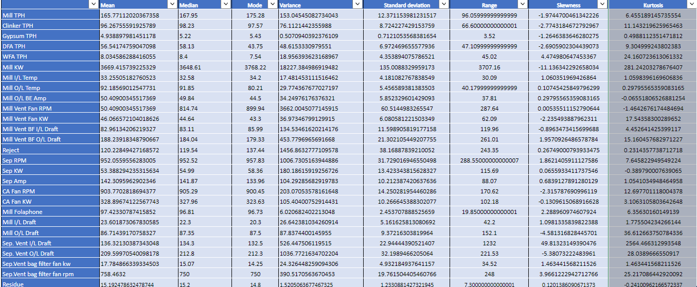
EDA

Slide 14
Missing Values Observation and Duplicates
Number of duplicate values: 5
Missing values are located in the following columns:
Columns | No. of missing values
DFA TPH | 1
Mill vent BF O/L draft | 1
Sep vent bag filter fan RPM | 1
Sep KW | 1

Slide 15
Outlier Detection
Columns | Percentage of outliers
Mill TPH | 2.76
Cilnker TPH | 2.65
Gypsum TPH | 9.76
DFA TPH | 6.94
WFA TPH | 2.43
Mill KW | 0.073
Mill I/L Temp | 4.96
Mill O/L Temp | 1.23
Mill O/L BE Amp | 0.67
Mill vent fan RPM | 0
Mill vent fan KW | 1.13
Mill vent BF I/L draft
Mill vent BF O/L draft | 12.91
Reject | 1.05
Sep KW | 6.48
Sep RPM | 0.25
Sep Amp | 0.99
CA fan RPM | 7.50
CA fan KW | 3.29
Mill folaphone | 24.39
Mill O/L draft | 12.91
Sep vent I/L draft | 2.12
Sep vent O/L draft | 5.83
Sep vent bag filter fan KW | 3.79
Sep vent bag filter fan RPM | 6.25
residue | 0.20

Slide 16
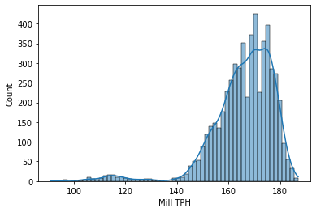
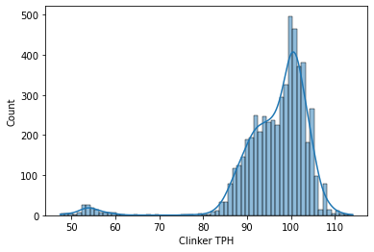
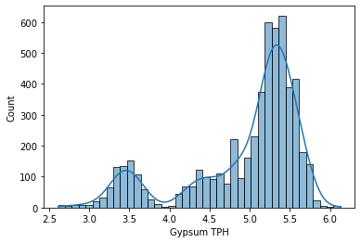
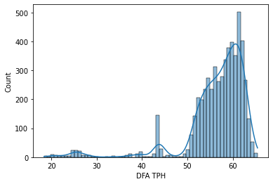
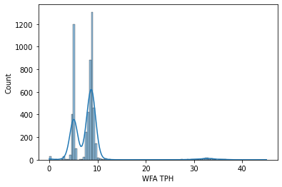
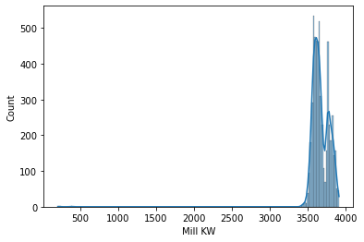
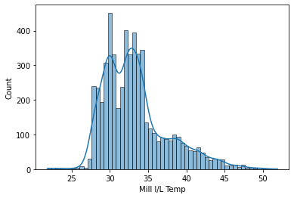
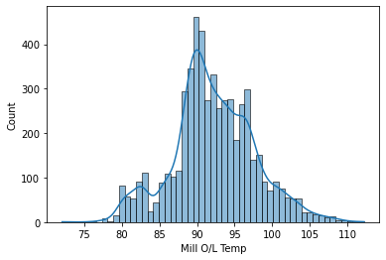
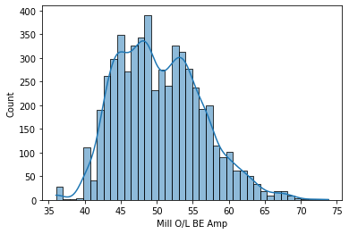
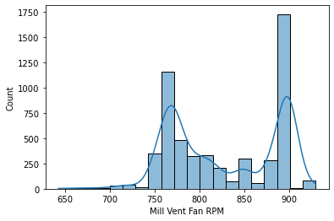
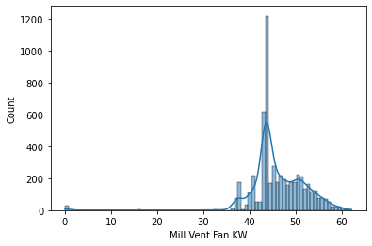
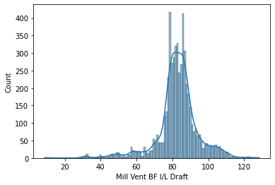
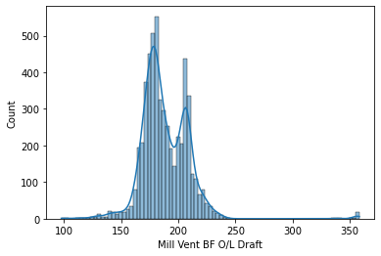
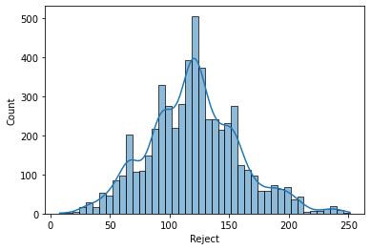
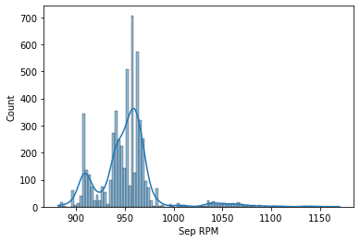
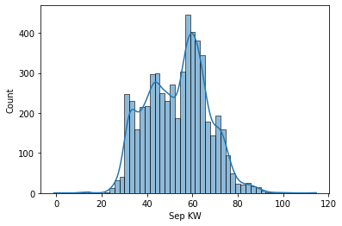
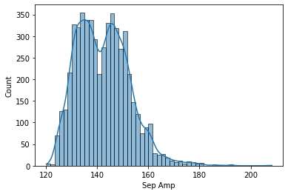
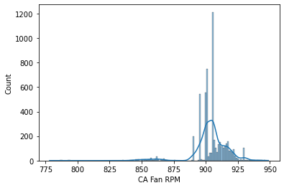
Histogram for each column before preprocessing
Notes:
Keep observations

Slide 17
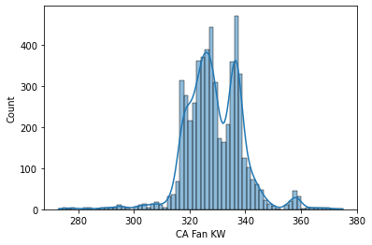
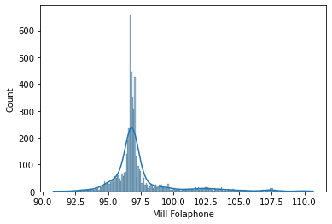
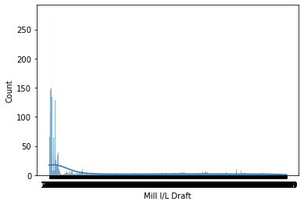
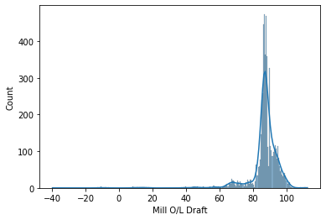
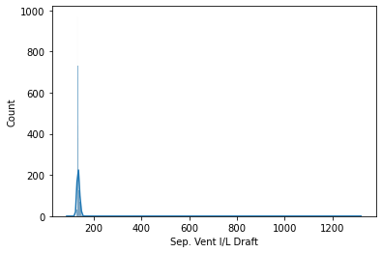
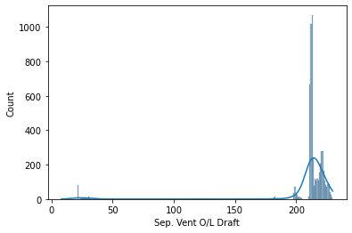
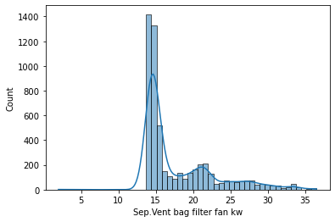
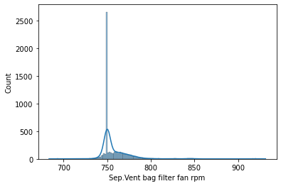
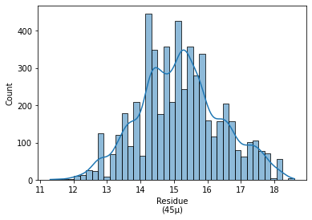

Slide 18
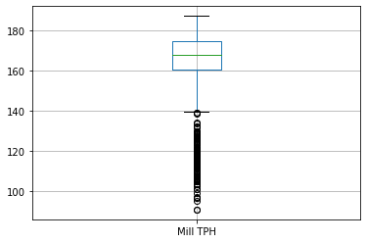
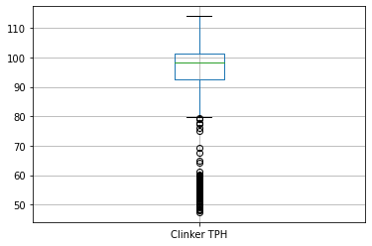
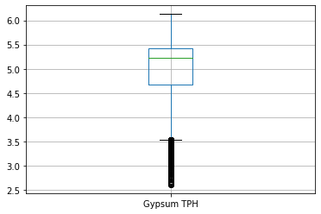
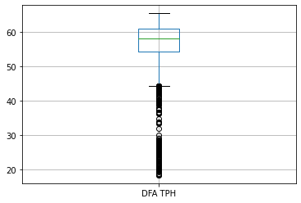
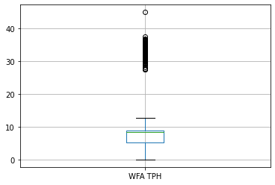
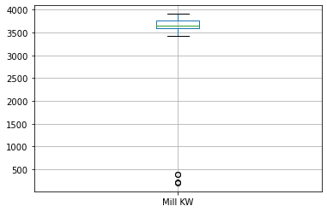
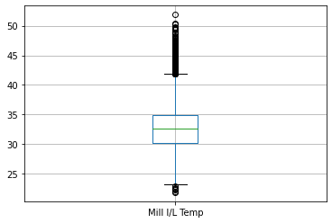
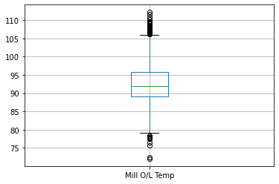
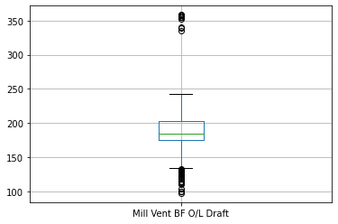
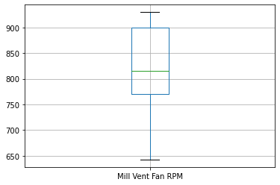
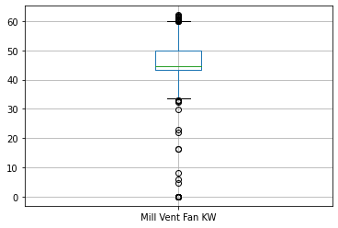
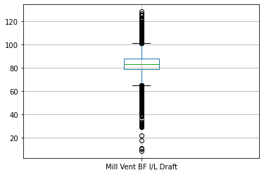
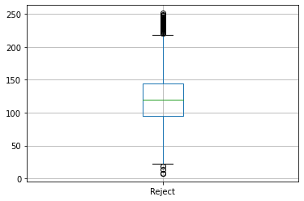
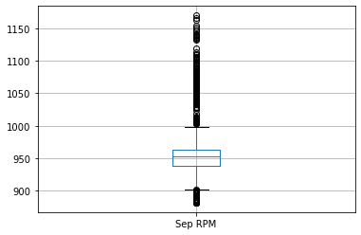
Boxplot to detect outliers

Slide 19
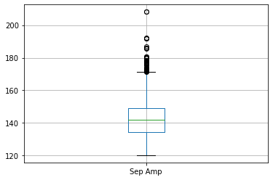
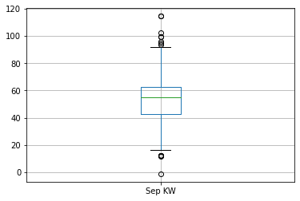
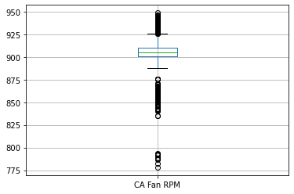
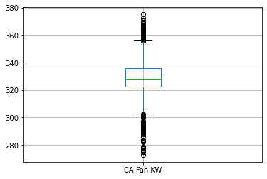
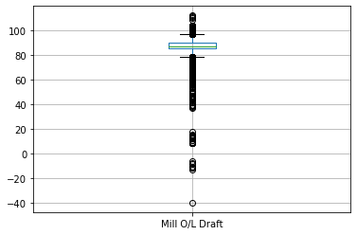
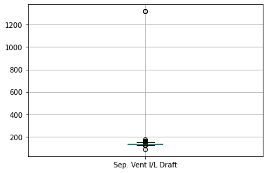
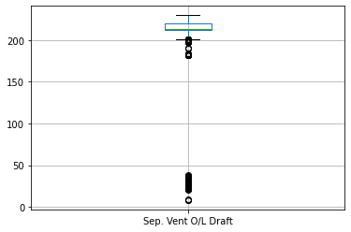





Slide 20
Inferences from EDA
First Business Moment: The mean, median and mode values ae determined for each variables which gives an idea about the average value and most frequently occurred values for each.
Second Business Moment: Variance, standard deviation and range will give an idea about the spread of the data
For Gypsum TPH the variance and standard deviation is near zero, which indicates that there is not that much difference between the points from the mean value. Ie, spread is less
For Mill KW, the standard deviation and variance shows really large value which indicates the spread of the data in really large or fatter distribution
Third Business Moment: Mill TPH, clinker TPH, Gypsum TPH, DFA TPH, Mill KW, CA fan RPM, Mill O/L draft, sep vent O/L draft are left skewed distributions. WFA TPH, Mill I/L temp, Mill O/L BE temp, Mill vent BF O/L draft, sep RPM, Sep Amp, Sep vent I/L draft, sep vent bag filter fan RPM are right skewed. For others the skewness is near zero which implies it is almost normal distribution.
Fourth Business Moment: Mill KW, Sep vent I/L draft have really big kurtosis values which indicates the really sharp peak.

Slide 21
Data preprocessing
Duplicates:
Duplicate records are removed from the data
Missing values:
Median imputation is used to treat missing values
Outliers:
Maximum outliers are replaced with 95th percentile and minimum outliers are replaced by 5th percentile. For Mill vent BF O/L draft, Mill folaphone and Mill O/L draft are not considered outlier treatment since it have more than 10% outliers present in it.
Transformation:
Corresponding transformation technique like boxcox transformation were used to make the variables normally distributed

Slide 22









Boxplots after preprocessing

Slide 24












Histograms after preprocessing

Slide 25











Slide 26

Data Visualization
Notes:
Add graphical

Slide 27
Future Scopes
By analyzing the data, optimization models can be built to maximize production of output (Mill TPH, Clinker TPH) by minimizing the input (DFA TPH, WFA TPH, Gypsum TPH etc.)
Models can be built to talk about quality of the product (based on Residue) in order to enhance the product consistency
Real time dashboards will help to get real time feedback on operations and management

Slide 28
Business insights
The average amount of residue at the end of the process is 15.20 which indicate the quality of the cement produce, where we can evaluate it whether it falls under the desired range or not. Here we consider the range of residue must fall under 12-14. So required changes must be done to improve the quality of the cement.
Only 15.20% of residue from the entire residue falls under the desired range which shows the need of improving the quality of cement.
Gypsum TPH, DFA TPH, Mill vent BF O/L draft, Mill folaphone and Mill O/L draft still have outliers in them which indicate there may be occasional inefficiencies that we need to recheck.

Slide 29
Challenges
Handling and analyzing large volumes of data might become a challenge.
There are variables like Mill vent BF O/L draft, Mill folaphone and Mill O/L draft which are not considered for outlier treatment since it have more than 10% outliers present in it. Also even after performing preprocessing variables like Gypsum TPH and DFA TPH are still contains outliers.
Even after performing transformation there are still some left where we can't completely convert them into normal distribution.

Slide 30

Queries ?

Slide 31


